Slide 1
Hotel booking Analysis Presented by: Pushpendra Choudhary
Capstone Project

Slide 2
Table of Content
EDA of Hotel Booking
Data Cleaning and Handling
Update Data Type
Exploratory Data Analysis
2. Conclusion

Slide 3
Problem Statements
Cancellation based on different factors like :-
Children or babies impact on cancellation
Here we will see if there is any trend for cancellation of those people having children
Booked and assigned room impact
If customer has been assigned a different room from what booked
Which customer type tend to cancel more

Slide 4
Data Summary
Data set name - Hotel Booking Analysis
Shape – 119389 rows × 31 columns
Columns - 'hotel', 'is_canceled', 'lead_time', 'arrival_date_year', 'arrival_date_month', 'arrival_date_week_number', 'arrival_date_day_of_month', 'stays_in_weekend_nights', 'stays_in_week_nights', 'adults', 'children', 'babies', 'meal', 'country', 'market_segment', 'distribution_channel', 'is_repeated_guest', 'previous_cancellations', 'previous_bookings_not_canceled', 'reserved_room_type', 'assigned_room_type', 'booking_changes', 'deposit_type', 'agent', 'days_in_waiting_list', 'customer_type', 'adr', 'required_car_parking_spaces', 'total_of_special_requests', 'reservation_status', 'reservation_status_date'

Slide 5
Cleaning dataset
We can see only a few columns had null values.
Column “Agent” had null values – after discovering I got to identify that I should swap the null by mode in this case.
Column “Company” was having a lot of Null values and there was no other detail regarding the same, so I just dropped the column
we can see 680 booking was there with no average rate, and also the stays of these guests were ZERO, that means, they have booked it but never showed up, so it should not be mention "check-out" in the "reservation status", we should replace it with something else -- NSU (never showed up(lets say))

Slide 6
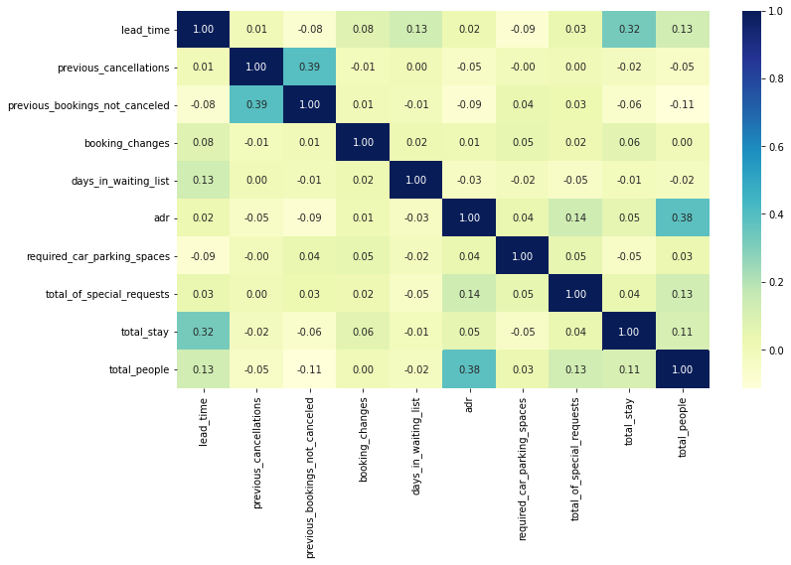
Correlation Heatmap
Previous cancellations and previous bookings not canceled are slightly correlated. It shows the fraction of Previous cancellations over previous bookings not canceled is 0.39.
Adr is slightly correlated with total people, which makes sense as more no. of people means more service to deliver, therefore more Adr.

Slide 7
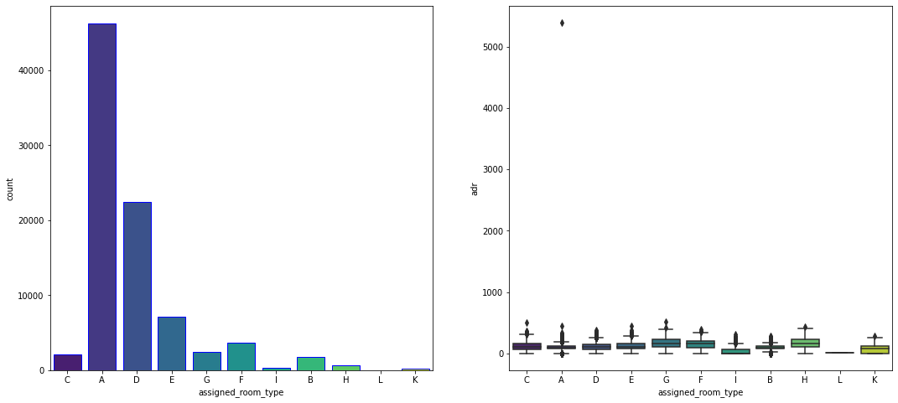
Room type which having highest adr
Room type A has highest customers demand
Room types C, G and H are some of the highest adr generating rooms.
Agent with id no.9 made most of bookings’

Slide 8
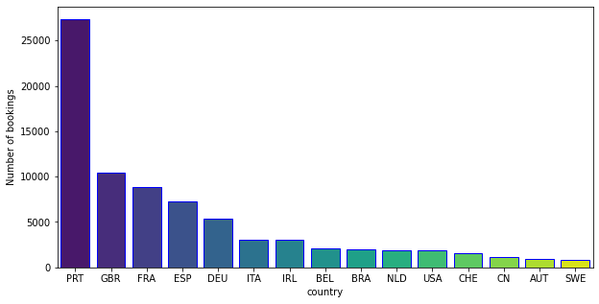
Problem Statements
Most of the customers from European countries like Portugal, Great Britain, France and Spain.
Most preferred meal type is BB (Bed and Breakfast)

Slide 9
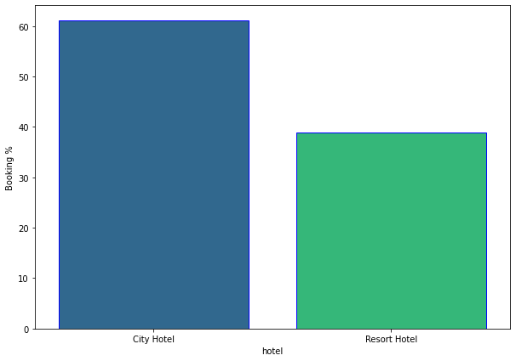
Problem Statements
Around 60% booking are for City hotel and 40% bookings are for resort hotel.

Slide 10
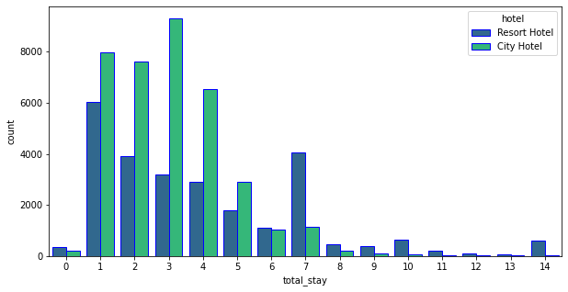
Problem Statements
Most of stays are less than 5 days. There are very few long stays at hotels but Resort hotel is preferred for long stays.

Slide 11
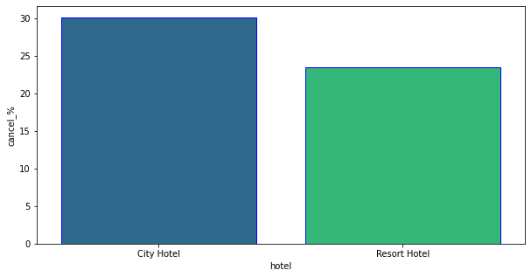
Problem Statements
Almost 30% of city Hotel bookings and 25% of Resort hotel bookings got canceled.

Slide 12
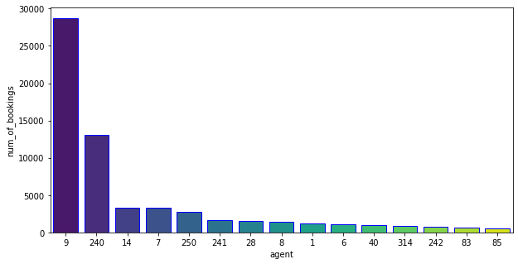
Problem Statements
Most of the customers from European countries like Portugal, Great Britain, France and Spain.

Slide 13
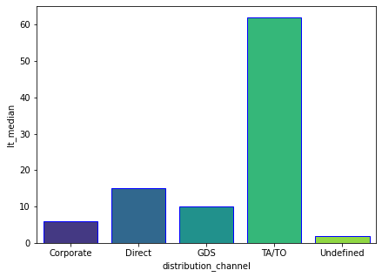
Problem Statements
Here we can see that the most of guest are making reservation through TA/TO channels which is travel agency and tour operator.
Channel which is mostly used for early booking of hotels is also TA/TO

Slide 14
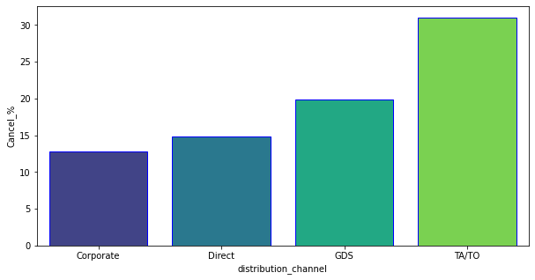
Problem Statements
TA/TO has highest booking cancellation %. Therefore, a booking via TA/TO is 30% likely to get cancelled.

Slide 15
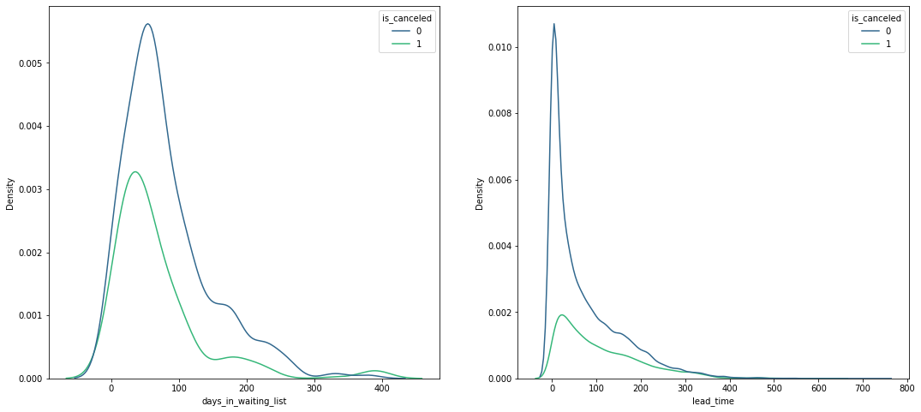
Problem Statements
Most of the bookings that are cancelled have waiting period of less 150 days but also most of bookings that are not cancelled also have waiting period of less than 150 days. Hence this shows that waiting period has no effect on cancellation of bookings.
Also, lead time has no effect on cancellation of bookings, as both curves of cancellation and not cancelation are similar for lead time too.

Slide 16
Conclusion
Around 60% bookings are for City hotel and 40% bookings are for Resort hotel, therefore City Hotel is busier than Resort hotel. Also the overall adr of City hotel is slightly higher than Resort hotel.
Mostly guests stay for less than 5 days in hotel and for longer stays Resort hotel is preferred.
Both hotels have significantly higher booking cancellation rates and very few guests less than 3% return for another booking in City hotel. 5% guests return for stay in Resort hotel.
Most of the guests came from european countries, with most no. of guest coming from Portugal.
Guests use different channels for making bookings out of which most preferred way is TA/TO.
For hotels higher adr deals come via GDS channel, so hotels should increase their popularity on this channel.Almost 30% of bookings via TA/TO are cancelled.
Not getting same room as reserved, longer lead time and waiting time do not affect cancellation of bookings.Although different room allotment do lowers the adr.
July-August are the most busier and profitable months for both of hotels.
Within a month, adr gradually increases as month ends, with small sudden rise on weekends.

Slide 17
Thank You

